Slide 1
MY OTHER GEEKY HOBBY

Slide 2
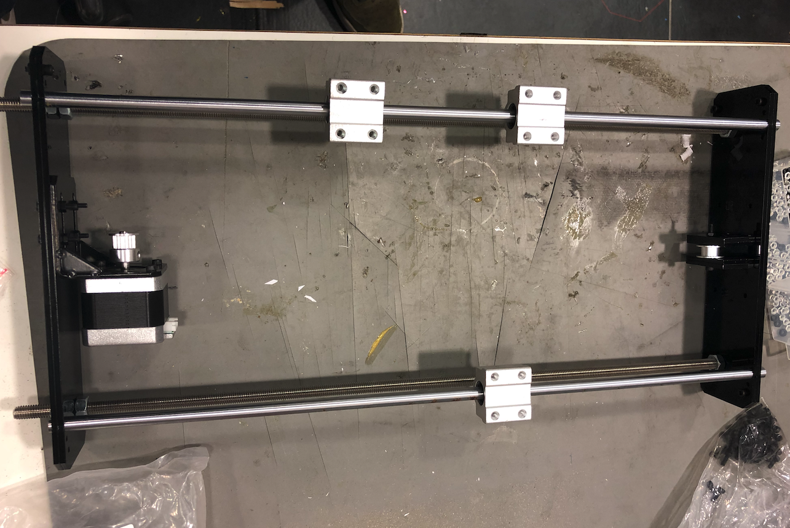
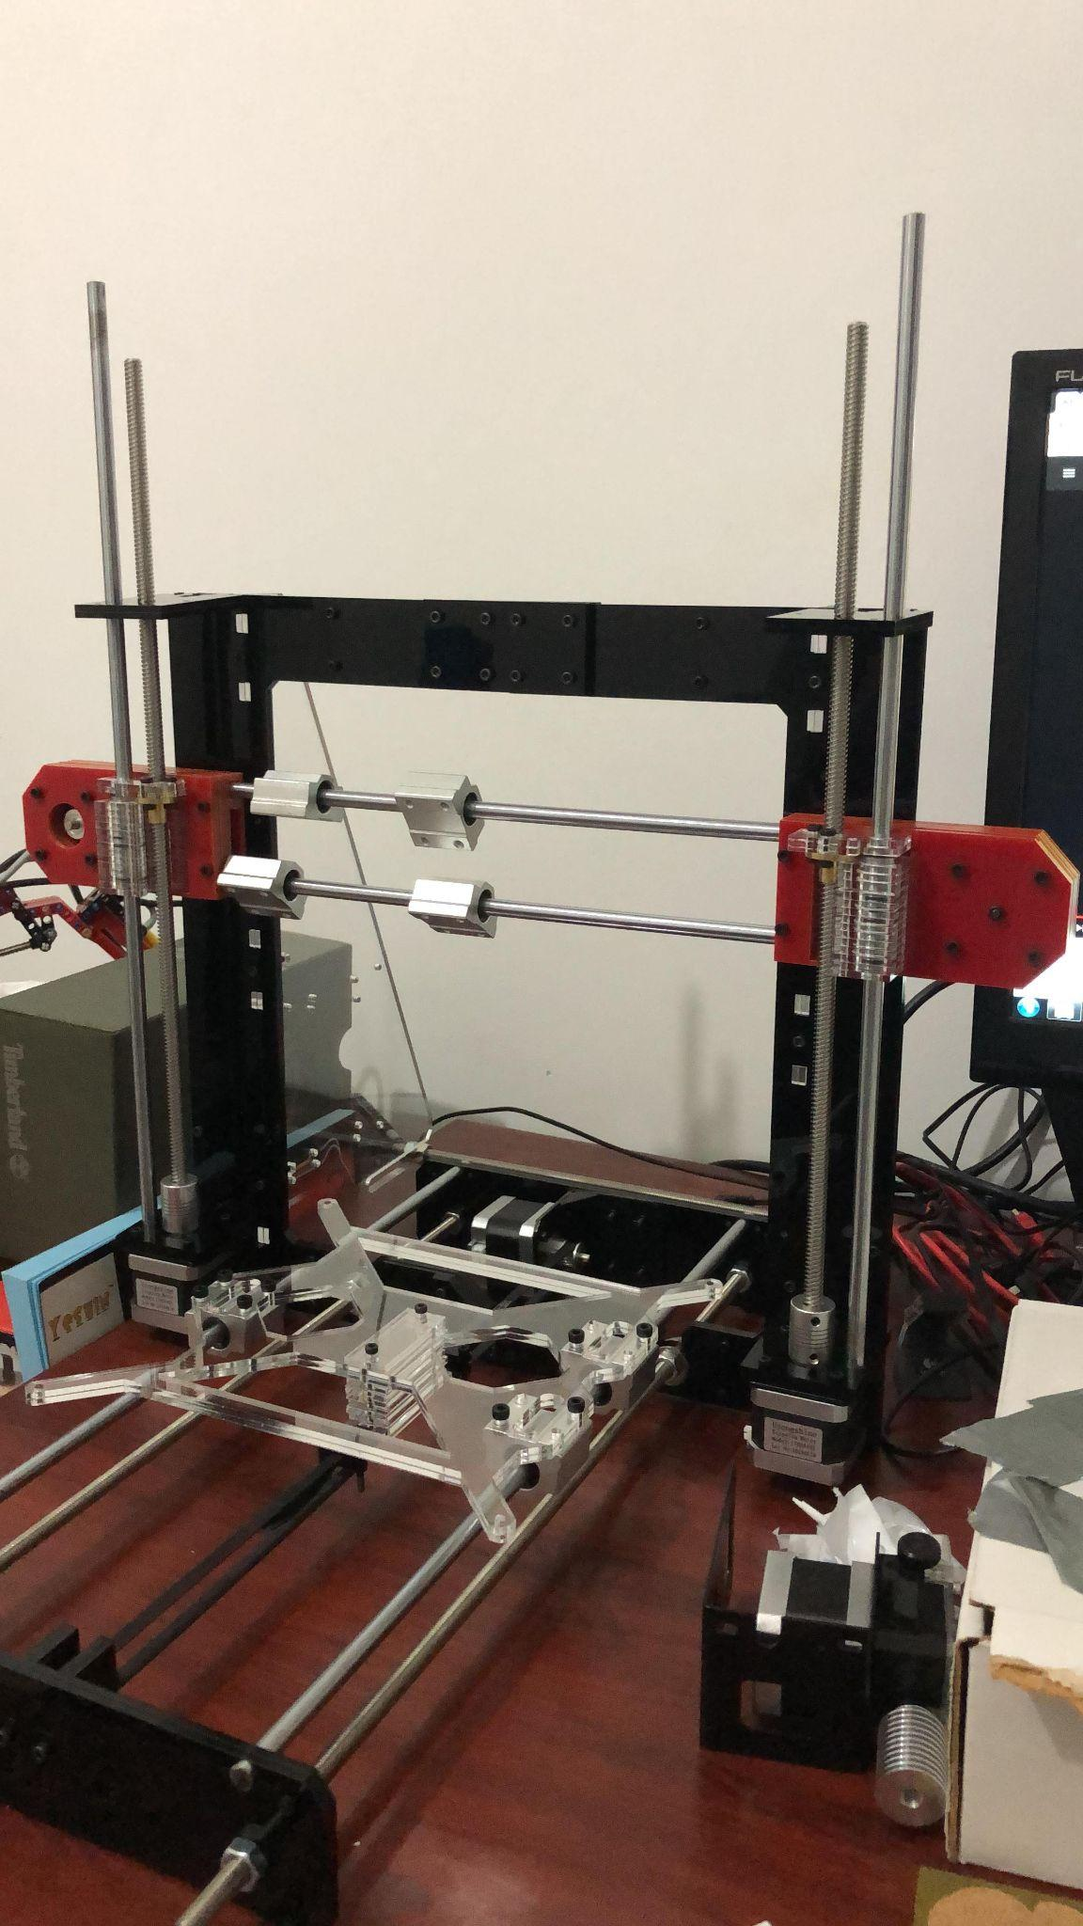
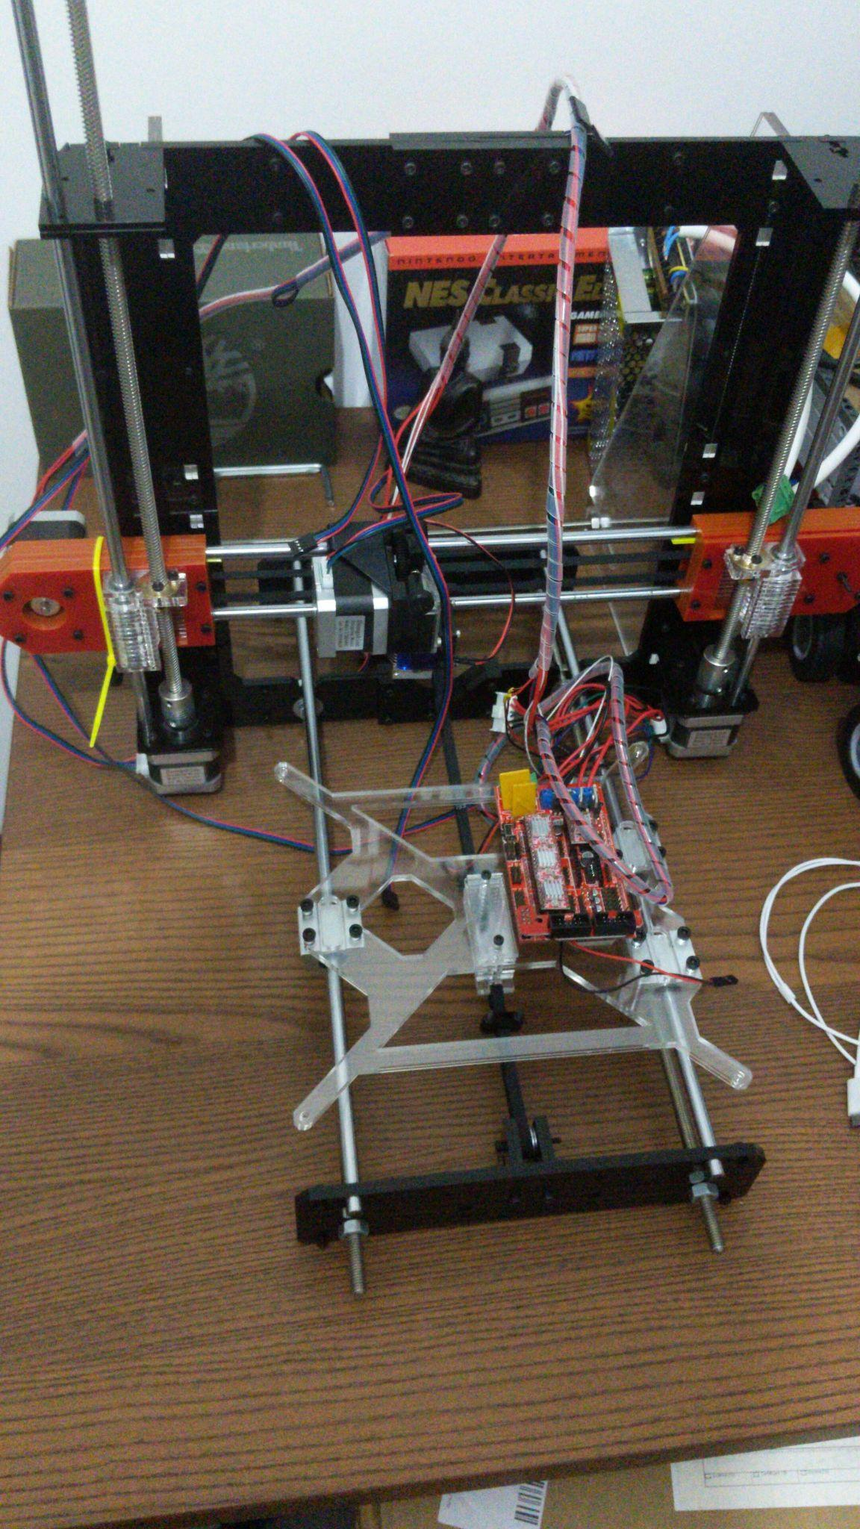
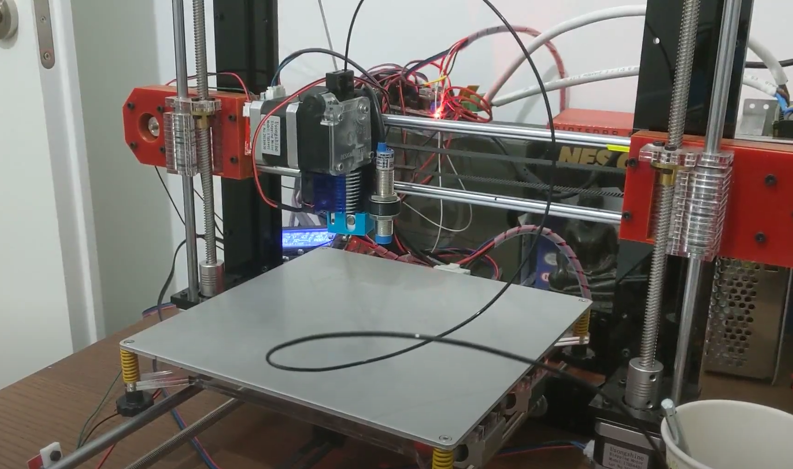

Slide 3
I'M NOT A GENIUS
Notes:
Im far from being a genius
These things really aren't complicated.
Everything is open source (and open hardware)

Slide 4
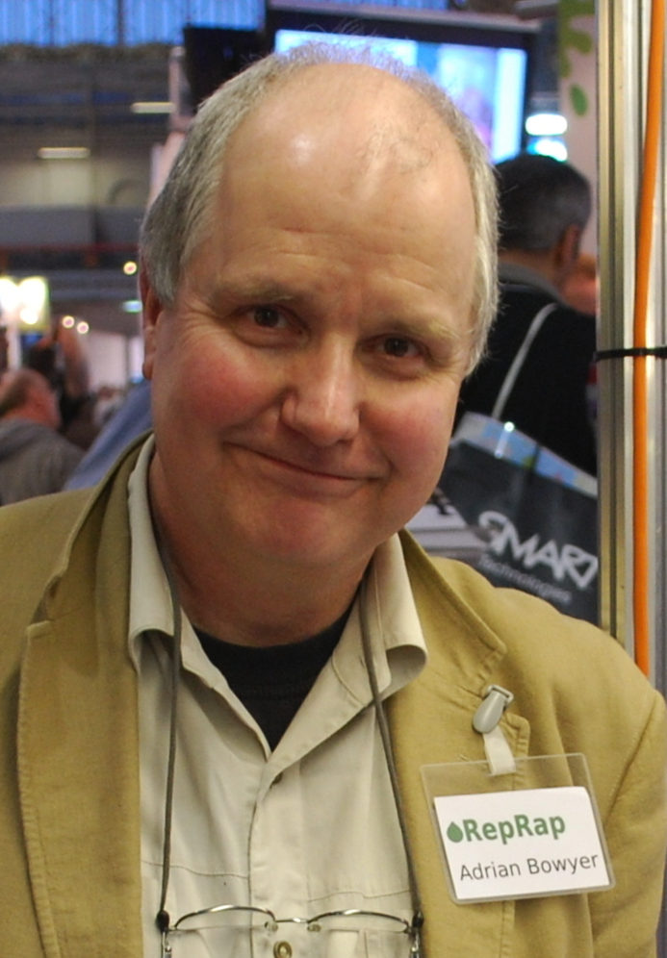

Slide 5
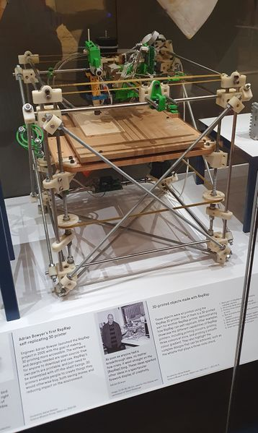
Notes:
Created the self replicating machine

Slide 6


Slide 7
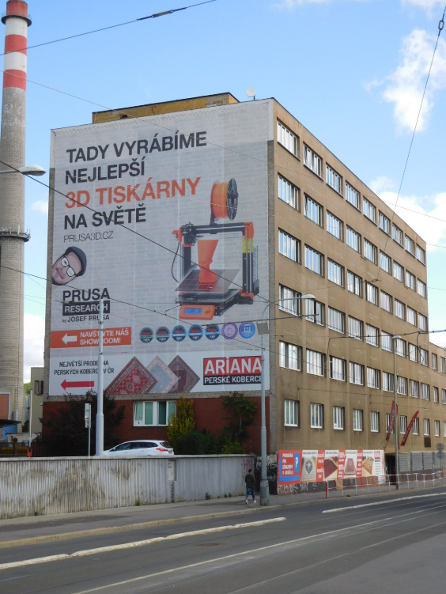
Notes:
Biggest 3d printer company

Slide 8
BUILDING
A CNC
MACHINE
Notes:
Computer numerical control
bunch of motors that move on different axis - controlled by a computer

Slide 9
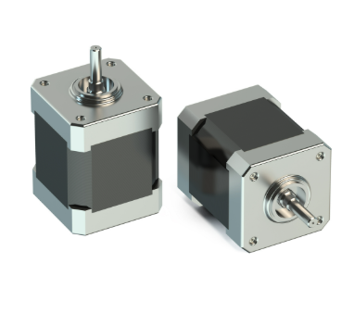
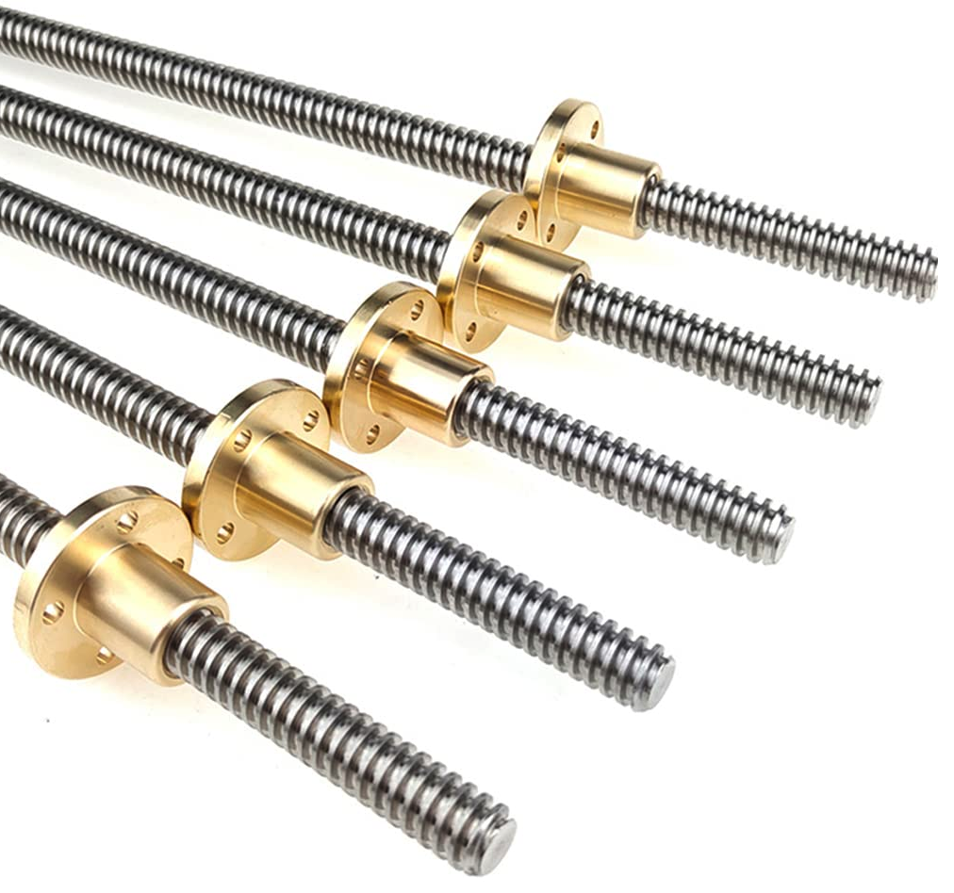
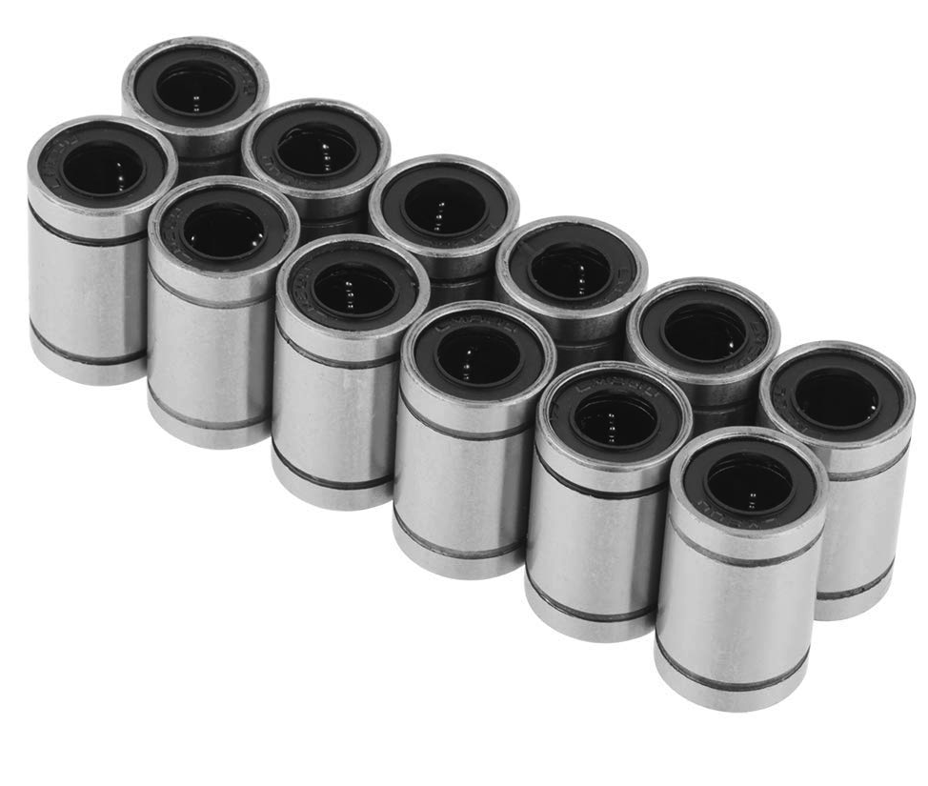
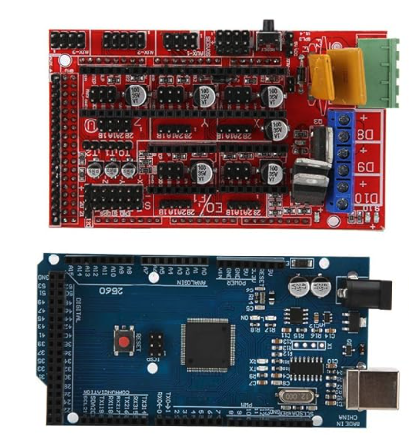
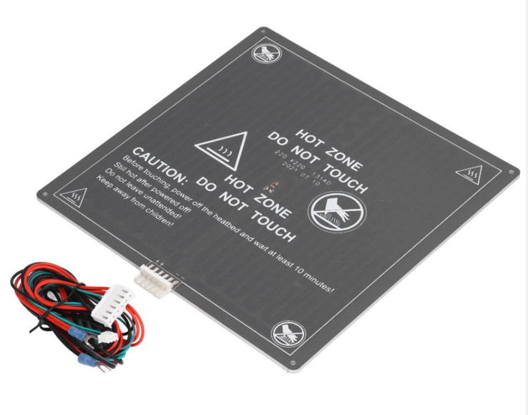
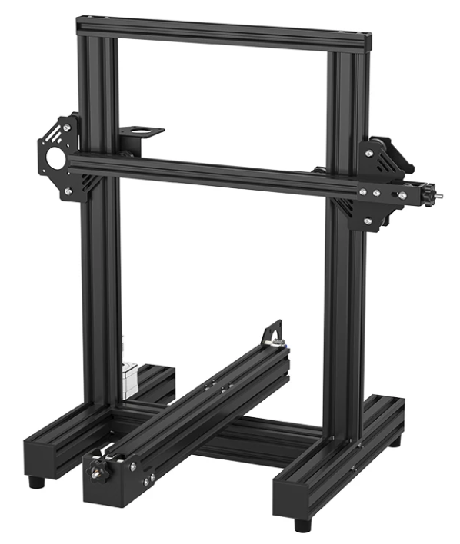
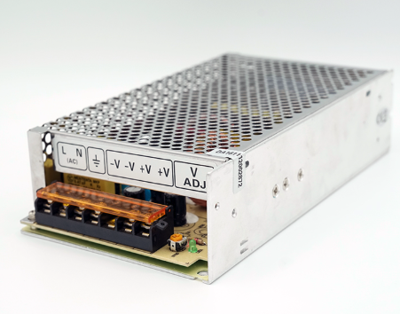
BUILDING

Slide 10
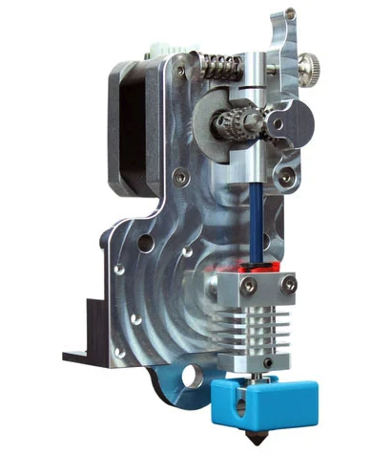
BUILDING

Slide 11
HOW IT WORKS

Slide 12
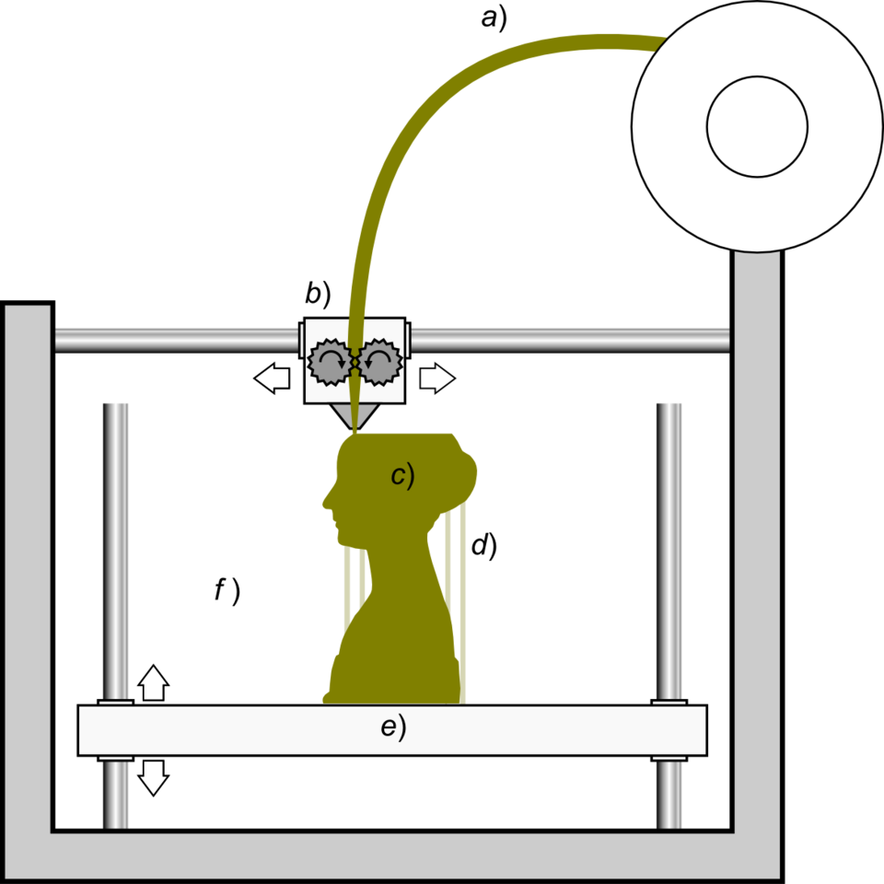
Notes:
filament - usually plastic
fused/melted through the hotend and stacked in layers

Slide 13
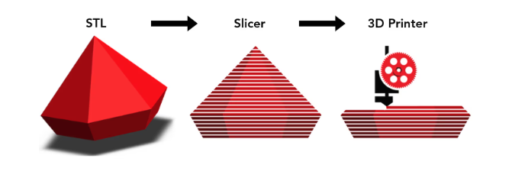
Notes:
so much goes into this....
Tons of mathematical calculations
Tons of chemical considerations
this differs by machine, material and capabilities

Slide 14
}
GCODE

Slide 15


}
GCODE

Slide 16
HARDWARE
🤝
SOFTWARE

Slide 17
WHERE ARE WE GOING?

Slide 18
multi material
tool changers
heated chambers
100s of materials
automated print farms
liquid based filament

